Slide 1



Helwan University
image processing
Project
Brain MRI tumar detection
Dr. Mohamed Sayed
Eng. Heidi Ahmed

Slide 2

Project Members
Aya Ahmed
Esraa Nasser
Amina Amer
Habiba Mohamed
Roaa Mohamed

Slide 3

Table of Contents
01
02
03
04
05
06
07
08
09
10
Introduction
Problem Statement
Project Summary
Justification of the Study
Theoretical and Conceptual Framework
Hypotheses and Research Questions
Applied Methodology
Relevant Results
Discussion of Results
References

Slide 4
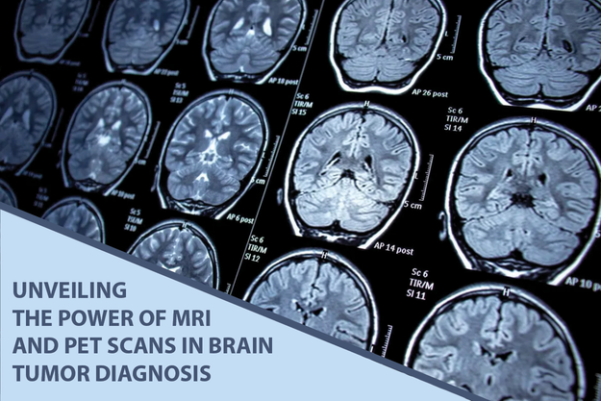
Introduction
Brain tumour classification from MRI scans is an essential task in medical diagnostics, enhancing the precision and speed of treatment planning.
This project introduces a deep learning model that automates the classification of brain tumours by leveraging a pre-trained convolutional neural network (CNN). The model processes MRI images and categorizes them into one of four possible classes: glioma, meningioma, pituitary tumor, or no tumor.

Slide 5


Mind Map
A broad category of neoplasms known as brain tumors is caused by abnormal cell development tin the brain or surrounding tissues.
MRI is the gold standard for brain tumour diagnosis because of its high-resolution pictures and capacity to view soft tissues.
Gliomas and meningioma are the most prevalent forms among them, however pituitary tumors also present serious clinical difficulties.
.Correct brain tumor diagnosis is essential since it directly affects treatment choices and patient outcomes.
Problem Statement
It is projected that 700,000 people in the United States alone receive a brain tumour diagnosis each year, as the prevalence of these tumours continues to climb
However, there may be differences and delays in diagnosis due to the growing complexity of imaging data and the inherent diversity in human interpretation.

Slide 6
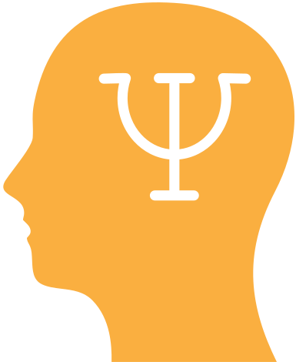
Project Summary
The goal of this research is to use convolutional neural networks (CNNs) to create an automated system for the identification and categorization of brain cancers in MRI images. We specifically concentrate on building a reliable CNN model that can discriminate between pituitary tumors, meningiomas, gliomas, and no tumor with high accuracy.
using dataset of MRI brain images, we Assessing the constructed model performance in terms of F1-score, accuracy, precision, and recall to ascertain its suitability for use in clinical settings.

Slide 7

Dataset
Total Images:
Data Sources:
The study utilizes a comprehensive dataset consisting of 7,023 MRI scans.
The images were aggregated from three reputable online
repositories to ensure diversity:
Br35H dataset.
SARTAJ dataset.
Figshare repository.
Labels:
The dataset is categorized into four distinct classes:
Glioma Tumor
Meningioma Tumor
Pituitary Tumor
No Tumor (Healthy)

Slide 8
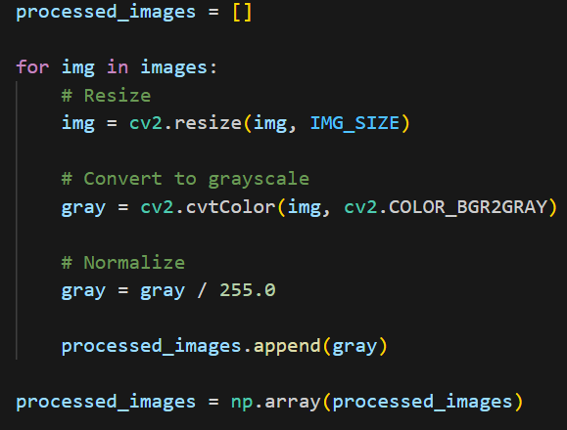
methodology overview
The proposed model is based on a Convolutional Neural Network (CNN) using Keras Sequential API.
Input: Preprocessed MRI images resized to a fixed size with converting to grey scale.
The model consists of multiple convolutional layers followed by pooling layers for feature extraction.
ReLU activation function is used to introduce non-linearity and enhance learning.
filters are applied in images to enhancement it like gaussian filter and clahe

Slide 9
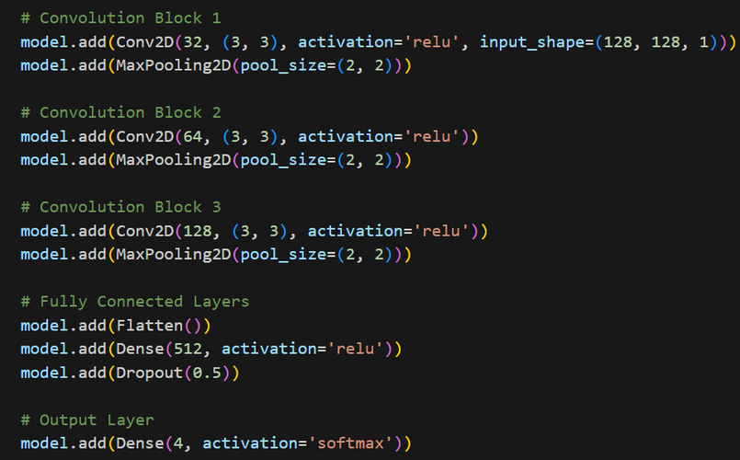
Feature Extraction & Regularization
Conv2D layers with increasing number of filters (32 → 64 → 128) are used to extract:
edges and textures in early layers where shapes and tumor-specific features in deeper layers.
MaxPooling (2×2) layers reduce spatial dimensions and computational cost.
Flatten layer converts 2D feature maps into a 1D feature vector.
A Dense layer with 512 neurons learns high-level representations.
Dropout (50%) is applied to reduce overfitting and improve generalization.

Slide 10

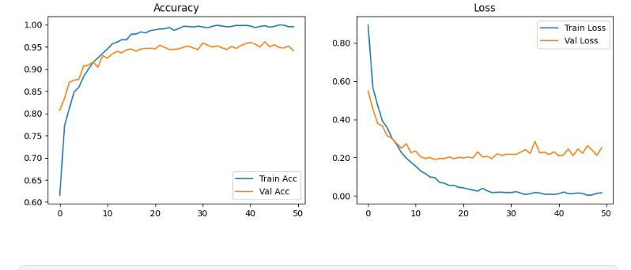
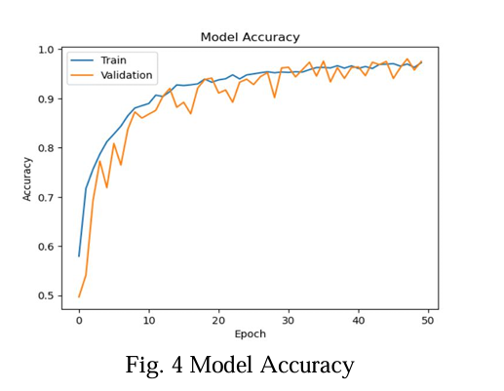
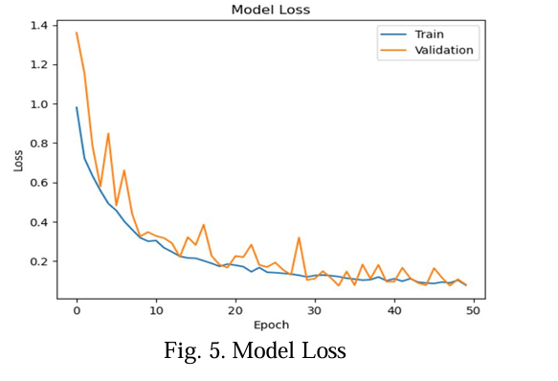
Relevant Results
Our model
Paper Results
achieved a stable learning curve with a final test accuracy of 94.16%. The curves show minimal gap between training and validation, indicating successful prevention of overfitting.
The paper reached a peak accuracy of 97.5%. Their
curves stabilized earlier
(around epoch 20) due to
the use of pre-trained architectures like ResNet50.
Accuracy & Loss Curves

Slide 11
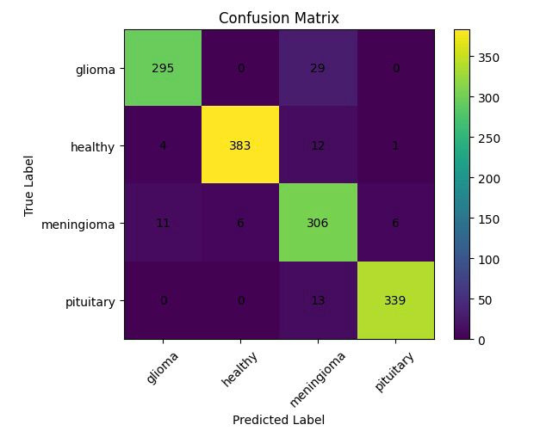
Relevant Results
Confusion Matrix Analysis
Our model
Our matrix shows exceptional performance in identifying "Healthy" scans and "Pituitary" tumors, with very few misclassifications.
Paper Results
The paper reported a
near-perfect classification
for the "No Tumor"
category, achieving a 100%
recall rate in their
best-performing model.

Slide 12
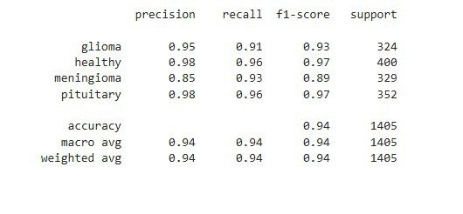
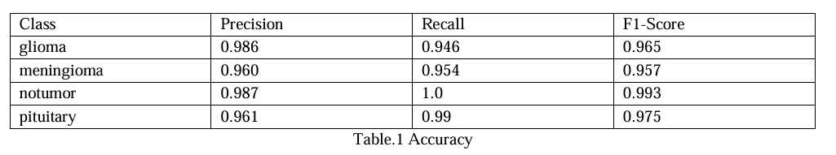
Relevant Results
Our model
We achieved a balanced
F1-score of 0.94, with high precision (0.98) in both
Healthy and Pituitary
classes.
Paper Results
Classification Report
The paper reported F1-
scores ranging from 0.95 to
0.99,with the highest
scores assigned to the
"No Tumor" class.

Slide 13
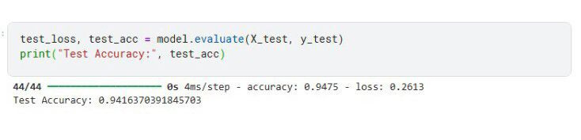
Relevant Results
Final Evaluation Result
Our model
The final evaluation
on unseen data
yielded a solid
94.16% accuracy.
Paper Results
The paper’s final
benchmark for
their CNN model
was 97.5%.

Slide 14



Helwan University
Thank You

Slide 15








Resources Page

